Slide 1

Strategic AI-Enabled Fund Management
Optimizing Expenditure, Forecasting, and Future Growth via Artificial Intelligence
OFFICE OF THE DIRECTOR OF FINANCE (DF) • BEL

Slide 2
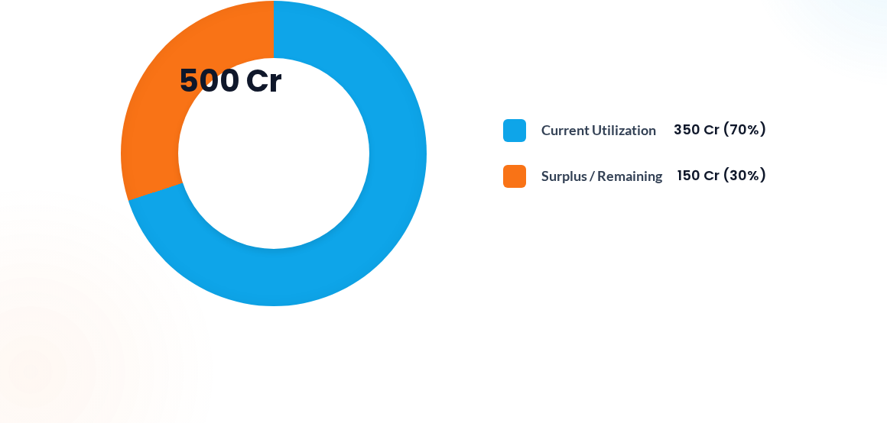
Executive Summary & Financial Snapshot

Slide 3


The Need for AI in Fund Utilization
Traditional Management
AI-Enabled Framework
Conventional budgeting often leads to trapped capital or underfunded critical services due to rigid allocation cycles and manual tracking methodologies.
Intelligent routing of funds ensures we utilize capital in a "better way" to maximize the impact of every rupee deployed.
Static, siloed fund allocation
Dynamic, data-driven fund shifting
Manual expenditure tracking
Automated tracking of Infrastructure & Capital
Reactive gap analysis
Zero omission of critical claims and services

Slide 4


Optimizing Operational Expenditure (OPEX)
Rework & Repair: AI models deploy predictive maintenance and automated quality control protocols to drastically reduce costly rework cycles.
Daily Expenditures: Real-time auditing of routine expenses eliminates operational bloat and identifies immediate cost-saving opportunities.
Service Optimization: By streamlining OPEX, we guarantee that the maximum number of daily services are funded without disruption.
Strategic Goal: Releasing trapped operational capital to fund critical strategic initiatives and next-generation engineering tasks.

Slide 5




Employee Welfare & Project Allocation
TA / DA (Travel & Dearness Allowance) AI-driven trend analysis optimizes travel budgets, predicting high-cost variables and recommending efficient geographic deployments.
Health & Welfare Forecasting employee medical claim expenditures accurately to ensure comprehensive health coverage without compromising cash flow.
Core Project Funding Ensuring automated, milestone-based liquidity for ongoing enterprise projects, preventing costly delays due to fund starvation.
R&D Segregation Ring-fencing vital Research and Development funds from daily OPEX to protect long-term innovation mandates.

Slide 6
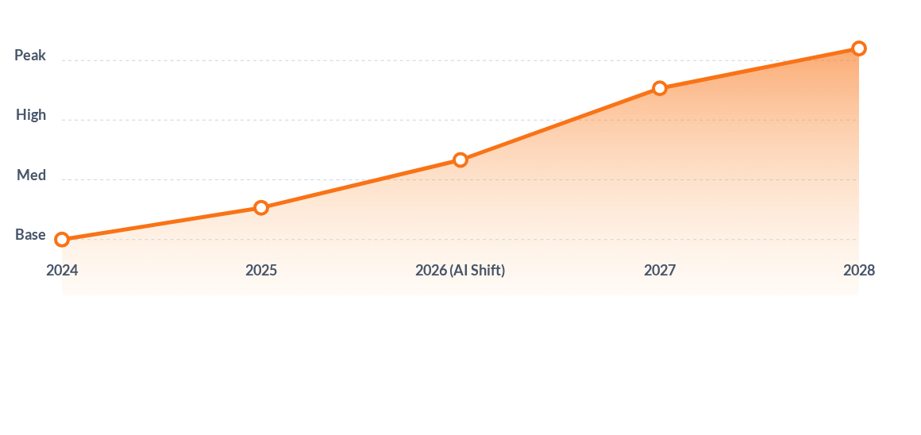
R&D and Future Business Potential

Slide 7

The AI Dashboard: Command & Control
Centralized Visibility: A unified AI-Dashboard designed specifically for the finance leadership, offering macro and micro views of enterprise-wide capital.
Dynamic Shifting: Automated monitoring enables agile "shifting of funds" between departments based on real-time needs and burn rates.
Proactive Action: Moving away from reactive, post-mortem auditing toward proactive financial steering and predictive interventions.

Slide 8




The Agile Forecasting Model
3 Months
9 Months
Tactical tracking of daily expenditures and immediate OPEX adjustments.
Strategic realignment of R&D investments and milestone assessments.
6 Months
12 Months
Re-allocation of surplus funds and mid-year capital project reviews.
Year-end target achievement, ensuring zero unspent critical capital.

Slide 9

Next 3-Year Budget Plan Implementation
Phase | Strategic Objective | AI Capability Deployed
Year 1 | Foundation & OPEX Control | Deployment of the central AI Dashboard for daily expenditure tracking.
Year 2 | Advanced Allocation | Predictive R&D funding and dynamic shifting of intra-department capital.
Year 3 | Autonomous Forecasting | Fully autonomous ML forecasting aligned directly with market business potential.

Slide 10


Securing the Future of BEL
AI is the definitive key to unlocking superior fund utilization. By transitioning to intelligent forecasting and dynamic shifting, we empower the organization to meet its financial and operational mandates with next-generation technological efficiency.

Slide 11



Image Sources
https://www.biworldwide.com/uk/wp-content/uploads/sites/16/2025/09/New-homepage-hero-template-file-1728x1080px-3.png
Source: www.biworldwide.com
https://png.pngtree.com/thumb_back/fw800/background/20260128/pngtree-futuristic-digital-dashboard-displaying-various-data-analytics-charts-and-graphs-with-image_21236983.webp
Source: pngtree.com
https://bricolagebombay.com/wp-content/uploads/2024/10/14-1.webp
Source: bricolagebombay.com

